Slide 1





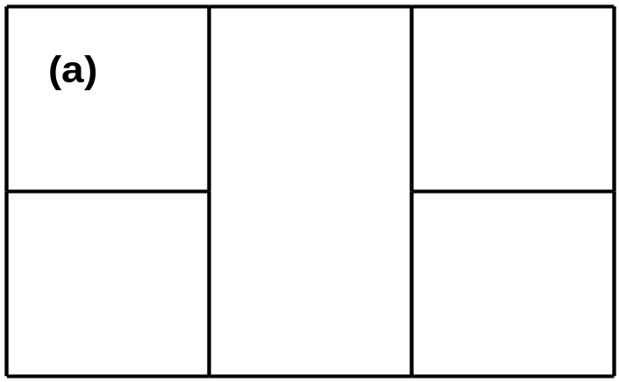
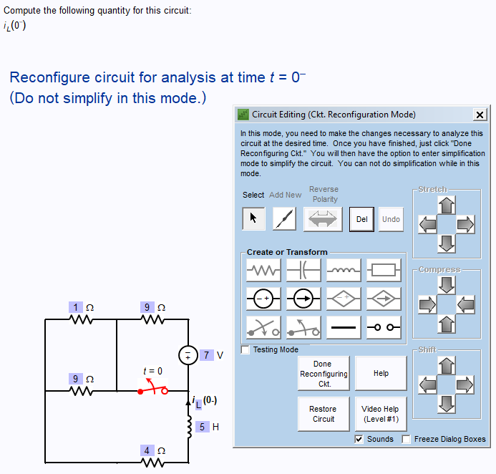
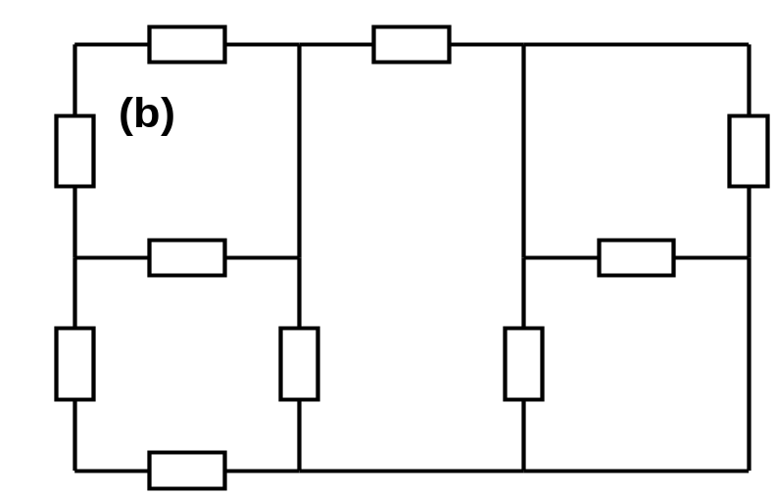
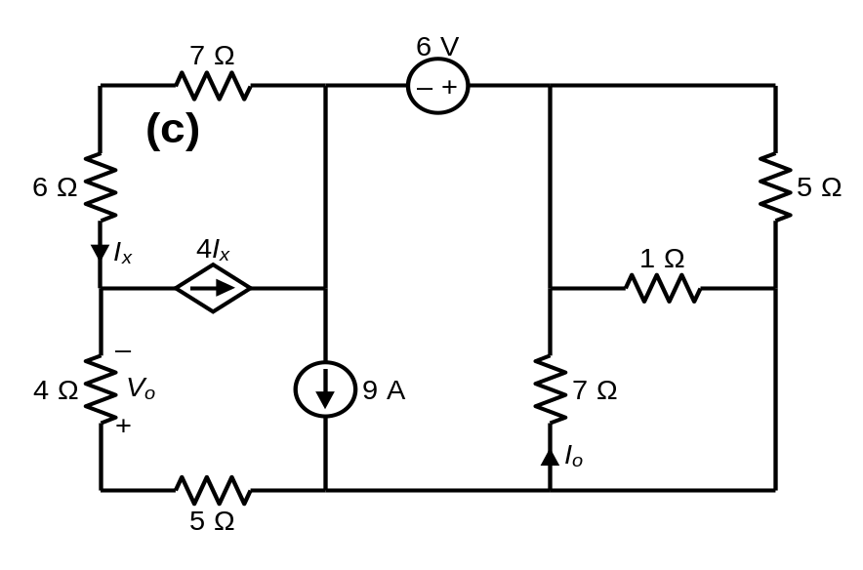
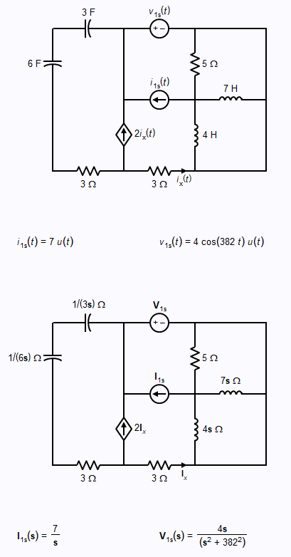
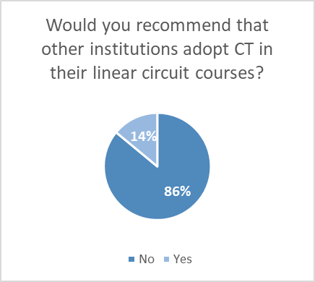
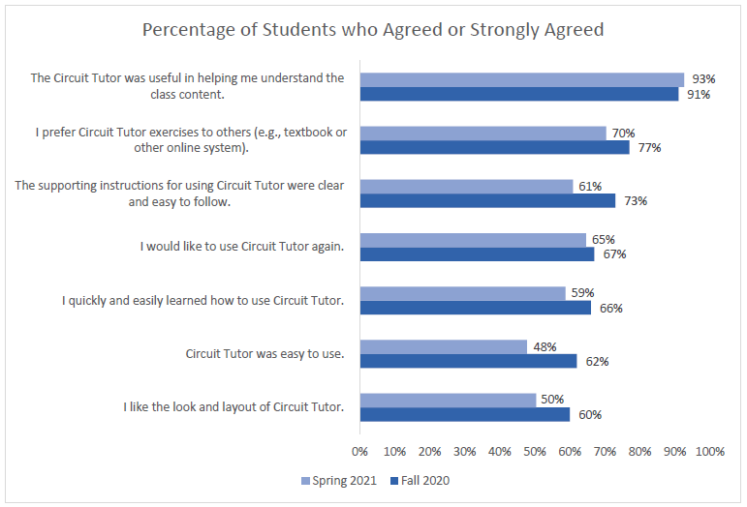
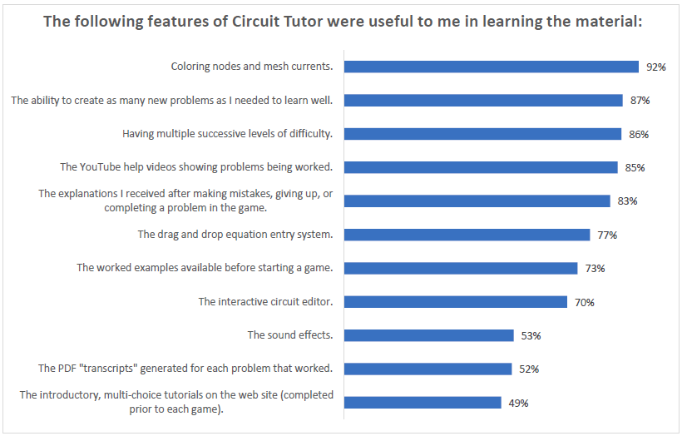
Advances in Step-Based Tutoring for Linear Circuit Analysis and Comprehensive Evaluation
Brian J. Skrommeª, R. Gupta^{b}, T. Nasim^{b}, C.J. Redshawª, B. Millerª, P. Andrei^{c}, H. Erives^{d},
D. Bailey^{e}, G. Wilkins^{e}, S. K. Bansal^{b}, M. A. O'Donnell^{f}, and W. M. Barnard^{f}
ªSchool of Electrical, Computer, and Energy Engrg., Arizona State Univ., Tempe, AZ 85287-5706 ^{b}School of Computing & Augmented Intelligence, Arizona State Univ., Tempe, AZ 85281
^{c}Dept. Of Electrical & Computer Engrg., FAMU-FSU College of Engrg, Tallahassee, FL 32310 ^{d}Electrical & Computer Engrg. Dept., Univ. of Texas at El Paso, El Paso, TX 79968
^{e}Dept. of Electrical & Computer Engrg., Morgan State Univ., Baltimore, Maryland 21251 ^{f}College Research and Evaluation Services Team, Arizona State Univ., Tempe, AZ 85287-2111
c
Introduction
Three-step Process for Circuit Generation
Example of a First-Order Transient Problem
Summary of Randomized, Controlled Experiments Comparing Circuit Tutor to Alternatives
A course in linear circuit analysis is foundational for electrical engineering students and is often required for many other engineering majors as well; e.g., over 1330 students took this course this year at ASU alone
Promoting success in such courses across diverse student bodies is a key goal, so considerable research has been carried out to do so, as reviewed, e.g., by Reagan et al. [1]
Step-based tutoring is one promising approach to achieve this aim. It involves checking every step of a student’s work using specialized interfaces to alert them immediately if they make a mistake, before they waste their time pursuing a dead end
A prior meta-analysis showed learning gains of 0.76σ, comparable to those achieved by very expensive expert tutoring (0.79σ), and significantly better than those usually found for answer-based systems such as those typically provided by publishers (0.31σ) [2]
Circuit problems pose a heavy intrinsic cognitive load on students due to their many interacting elements, and threaten to overload students’ working memories
Providing an unlimited supply of randomly-generated and fully worked examples can minimize the cognitive load while adapting to the needs of each student. Problems are generated the same way to supply different ones as needed by each and every student, so that copying from solution manuals or from others is impossible
Here, we describe recent progress including problems on first- and second-order transients as well as preliminary work on Laplace transform-based circuit analysis and a comprehensive evaluation of this system by an independent evaluation team supported by the project
Date | Location | Lab/Classroom-Based | Module(s) Evaluated | Control Condition | Random Assignment? | Pre-Test Description | Post-Test Description | Blind Grading? | N | p | Effect Size (Cohen d-value) | Student Survey Results
12/2012 | ASU | Lab (Paid student volunteers in circuits course within last year) | Series/Parallel 1.0, DC Node Equations | Worked similar textbook problems on paper (no feedback) | Yes | 25 min. Paper Test | Same (two forms used randomly) | Yes | 33 | <0.05* | 1.21 | d = 0.91 (p < 0.05) on Instructional Materials Motivation Survey
Fall 2014 | ASU | Classroom-based (one section) | DC Node Equations, DC Node Solutions, DC Mesh Equations, DC Mesh Solutions | Worked similar problems in WileyPLUS | Yes (ea. student used Circuit Tutor modules on 1 topic, WileyPLUS on the other) | None | Compared scores on the HW Assignment | Yes | 73 | 0.0084* | 0.41 | None (but 33% of students then did voluntary work in CT, none did so in WileyPLUS)
Fall 2014 | Univ. Notre Dame | Classroom-based (two sections) | Series/Parallel 1.0, Series/Parallel with Terminals | Read textbook discussion, did paper problems | No; different sections assigned to different conditions | Paper Test | Same (two forms used randomly) | Yes | 32 total | <0.001* (1-way AOV with pre-test as co-variate) | 0.97 | None
Fall 2015 | ASU | Classroom-based (one section) | DC Node Equations, DC Node Solutions, DC Mesh Equations, DC Mesh Solutions | Worked similar problems in WileyPLUS | Yes (ea. student used Circuit Tutor modules on 1 topic, WileyPLUS on the other) | None | Paper Quiz (45 min.) | Yes | 70 | Node anal.: <0.05* Mesh anal.: 0.38 | Node anal.: 0.72 Mesh anal.: [0.21] (not signif.) | 86% preferred CT, 9% preferred WP
Spring 2019 | ASU | Classroom-based (one section) | DC Superposition, DC Source Transformations | Worked similar problems in WileyPLUS | Yes (ea. student used Circuit Tutor modules on 1 topic, WileyPLUS on the other) | None | Limited; one 12-pt. problem on each topic on 100-pt. exam | Yes | 62 | DC Superpos: 0.56 DC Src Trnsfrm.: 0.92 | DC Superpos: [ 0.026] DC Src Trnsfrm.: [-0.15] (neither signif.) | DC Superpos: 84% preferred CT, 11% preferred WP DC Src. Transfrm: 68% preferred CT, 23% preferred WP
Fall 2019 | ASU | Classroom-based (Section 1) | DC Superposition, DC Source Transformations, DC Thevenin/Norton, AC Analysis (same 3 topics) | Worked similar textbook problems on paper (no feedback) | Yes (ea. Student used CT modules for DC or AC topics, randomly assigned) | None | DC Topics: 100 pt. quiz, 2 questions on exam (38 pts); AC Topics: 1 question (22 pts.) on exam | Yes | 53 | DC Quiz: 0.53 DC Exam†: 0.94 AC Exam‡: 0.55 | DC Quiz: [-0.13] DC Exam: [0.033] AC Exam: [-0.26] (none signif.) | (Sections merged for survey) Paper HW users would prefer different HW system more than CT users (p = 0.000, d = 2.07); CT helped learn better than paper (p = 0.000, d = 1.11)
Fall 2019 | ASU | Classroom-based (Section 2) | (Same as above) | (Same as above) | (Same as above) | None | (Same as above) | Yes | 59 | DC Quiz: 0.046* DC Exam†: 0.014* AC Exam‡: 0.64 | DC Quiz: 0.54 DC Exam: 0.64 AC Exam: [-0.13] (not signif.)
Randomly-Generated Laplace Transform Problem
Evaluation--Instructor Surveys
†Some cross-contamination, probably reduced effect size
‡Heavy cross-contam. from prior expt.; prob. invalid
*Statistically significant result
Instructors were surveyed in Spring 2021. Generally, they had favorable teaching experiences using Circuit Tutor.
Overall, 57% (4 out of 7) of instructors reported that Circuit Tutor made teaching their classes more effective than the previously used homework system used to teach students and 57% (4/7) reported that Circuit Tutor made it somewhat or much easier to teach their classes compared to other types of homework systems for that class.
Slightly less than half of the instructors (43%; 3/7) reported that their students were somewhat more motivated or much more motivated to study linear circuit analysis when using Circuit Tutor compared to the other homework system.
Overall, the instructors were satisfied with their experiences using Circuit Tutor as shown through the high percentages of instructors who would recommend Circuit Tutor to other instructors (86%; 6/7
100% of the instructors reported having adequate administrative support in the program (gradebook, etc.).
Independent Evaluation Questions & Methodology
1. To what extent was Circuit Tutor implemented effectively across the four partnering universities?
2. How did students perceive the utility of Circuit Tutor in supporting their course learning?
3. How did instructors perceive Circuit Tutor to impact their teaching experiences?
4. How did instructors perceive their students to experience Circuit Tutor in their course learning?
5. To what extent were students satisfied with Circuit Tutor?
Evaluation covered Fall 2020 and Spring 2021 semesters
A mixed methods approach was utilized through the combination of student and instructor surveys and document review
The survey captured both quantitative and qualitative data using Likert scale items and open-ended questions
Across both semesters:
30 Circuits I courses taught (1,434 students) and one Circuits II course (40 students)
Total of 17 distinct instructors taught a total of 33 class sections during this time at the four institutions
A total of 21 different games (tutorials) were used
Of the total students listed within the Circuit Tutor database, 1223 were at ASU, 59 at FAMU/FSU, 91 at MSU, and 101 at UTEP
Overall, students had very favorable experiences using Circuit Tutor across these two semesters. At least 48% of responding students in the Fall 2020 semester and 60% of students in the Spring 2021 semester agreed or strongly agreed with all these survey items on favorable aspects of Circuit Tutor
Summary
Circuit Tutor has been used to date by over 9000 students (active users) in 249 distinct class sections taught by 67 distinct instructors at 16 different colleges & universities of diverse types (five minority-serving) and has been shown to be widely effective
Seven controlled evaluations (6/7 randomized) of 10 different modules showed statistically significant effect sizes of 1.21, 0.41, 0.97, 0.72, 0.54, and 0.64 std. deviations (Cohen d-values) and five (non-cross-contaminated) cases with no significant difference, compared to paper HW or the commercial WileyPLUS system
Comprehensive independent evaluation showed high opinions of both students and instructors (86% of latter would recommend adoption) and ranked popularity of features
Student survey results showed very strong preferences for Circuit Tutor over paper HW or two different commercial answer-based systems (WileyPLUS, Pearson Mastering), e.g., 86%-9%,
84%-11%, 68%-23%, 69%-12%, or d = 0.91, d = 2.07, d = 1.01)
Pedagogical innovations include color-coded nodes and meshes, and conceptual emphasis
Student support features include 83 YouTube videos covering all problem types, introductory multiple-choice tutorials (new or custom ones can be created directly from a specially-formatted Word document), and auto-generated transcripts of student work to use in reviewing
Topical coverage now includes 23 games covering most major course topics, now including first and second-order transient problems; additional ones in development
Evaluation—Student Surveys
References
T. J. Reagan, S. Claussen, and E. Lyne, “Systematic review of rigorous research in teaching introductory circuits,” in ASEE Virt. Annu. Conf. & Exposit., 2020, pp. DOI 10.18260/1-2--35265.
K. VanLehn, “The relative effectiveness of human tutoring, intelligent tutoring systems, and other tutoring systems,” Educat. Psychologist, vol. 46, pp. 197-221, 2011.
For Further Information or to Use this FREE Software in Your Classes
Contact Brian J. Skromme, School of Electrical, Computer, and Energy Engineering, Arizona State University, Box 875706 Tempe, AZ 85287-5706 e-mail: skromme@asu.edu For more information: www.circuittutor.com
Acknowledgments
This work was supported by the National Science Foundation through the Transforming Undergraduate Education in Science, Technology, Engineering and Mathematics Program under Grant Nos. DUE-1044497 and DUE-1323773. We thank the many instructors who used Circuit Tutor in their classes.

